Slide 1

Electrical Diagrams, Wiring Layout and Best Practices
Mater Dei Robotics

Slide 2
Agenda
Mater Dei Robotics
Ladder Diagrams
Component Layout
Good Wiring Practices

Slide 3
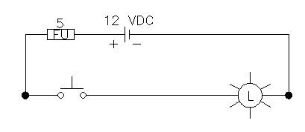

Ladder Diagrams

Slide 4
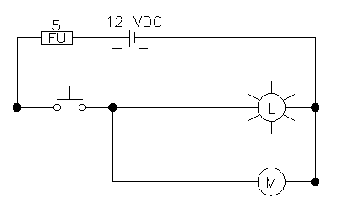
Ladder Diagrams

Slide 5
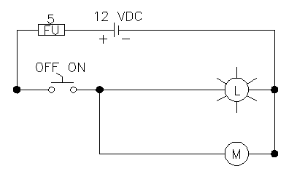
Ladder Diagrams

Slide 6
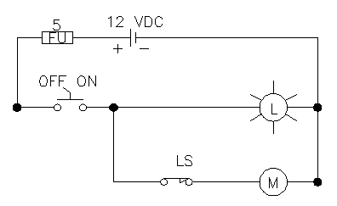
Ladder Diagrams

Slide 7
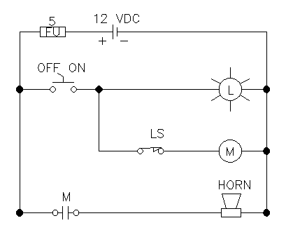
Ladder Diagrams

Slide 8
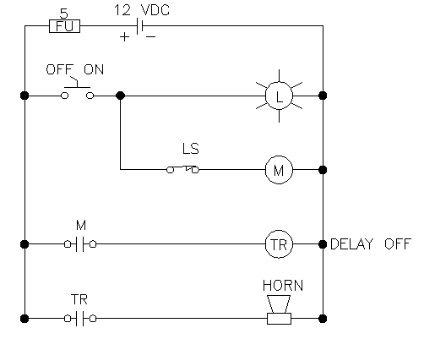
Ladder Diagrams

Slide 9
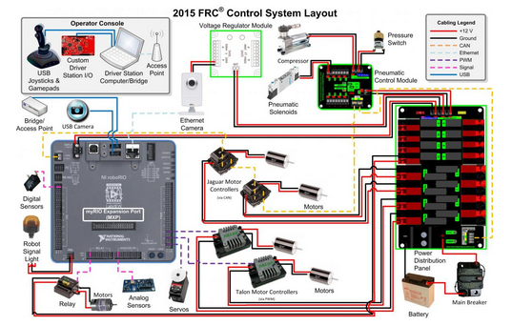
Component Layout

Slide 10
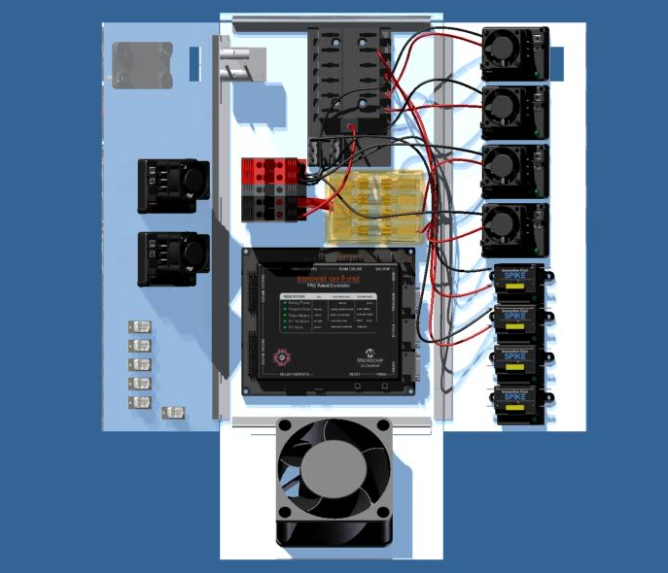
Component Layout

Slide 11
Best Practices
Route wires in wireway, where possible
Keep wires from twisting in wireway
Avoid pinch points
Remove excess wire
Remove unused wires
Use correct wire gauge and color: red (+) and black (-)
Properly label all wires (both ends)
Use correct size and type of crimp fitting for the wire being used
Design sub-systems as plug-and-play

